Slide 1
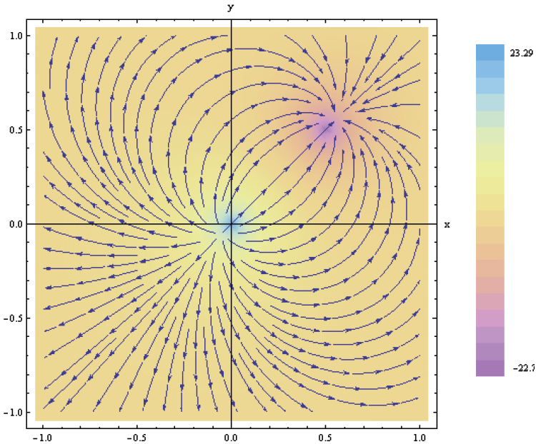
3. Vector Analysis
7e Applied EM by Ulaby and Ravaioli

Slide 2
Chapter 3 Vector Analysis

Slide 3
Vector basics

Slide 4
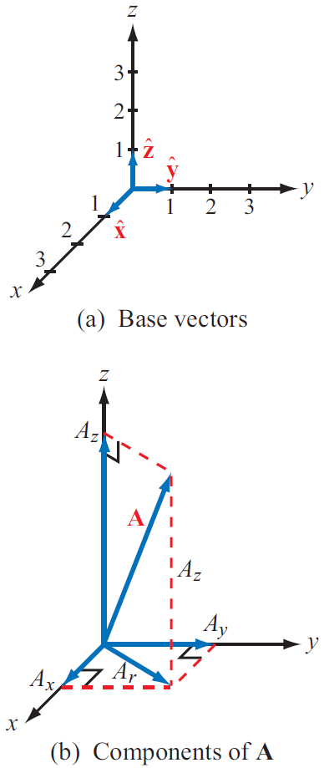
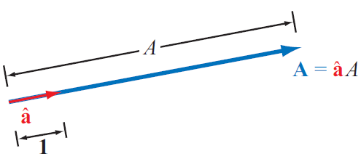
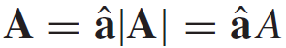
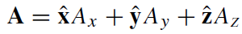
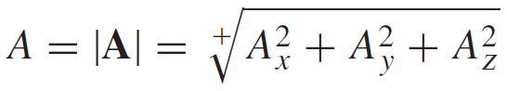
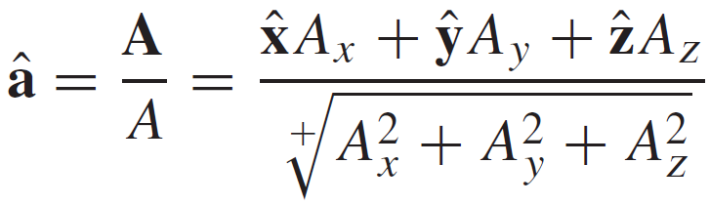
Laws of Vector Algebra

Slide 5
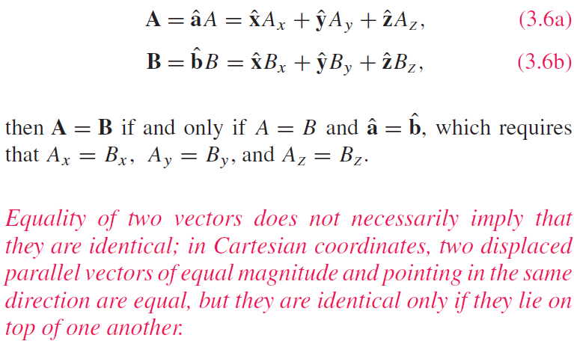
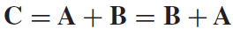
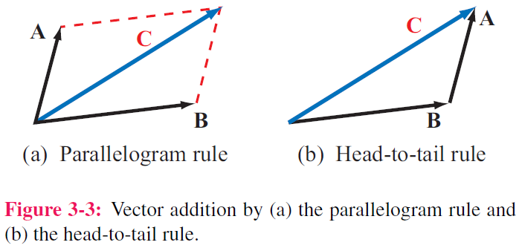
Properties of Vector Operations
Equality of Two Vectors
Commutative property

Slide 6
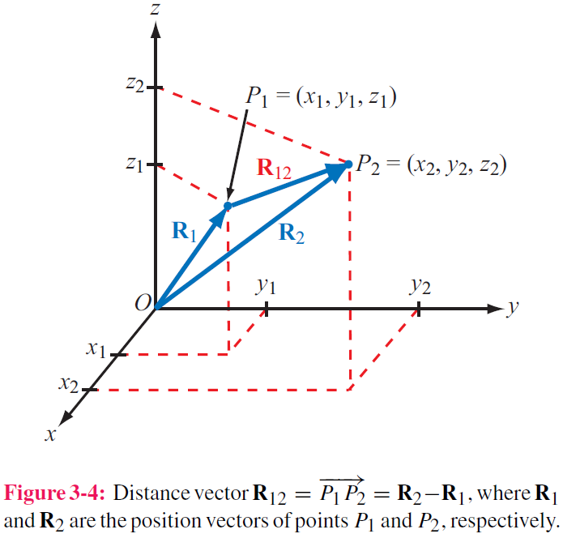
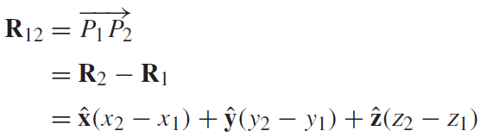
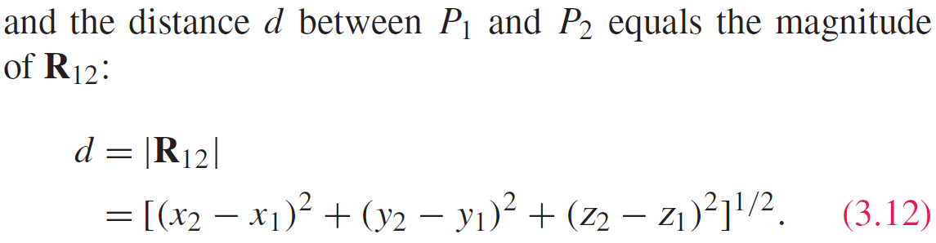
Position & Distance Vectors
Position Vector: From origin to point P
Distance Vector: Between two points

Slide 7
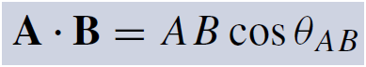
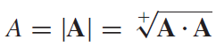
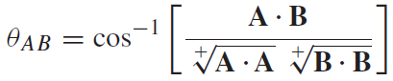
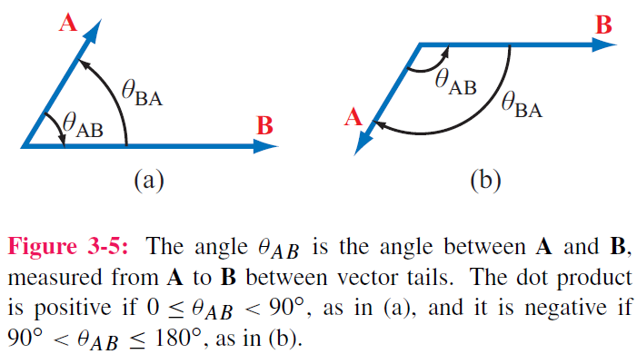
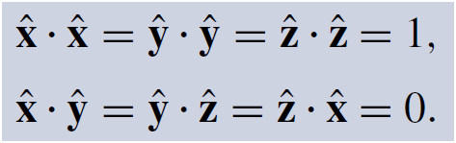
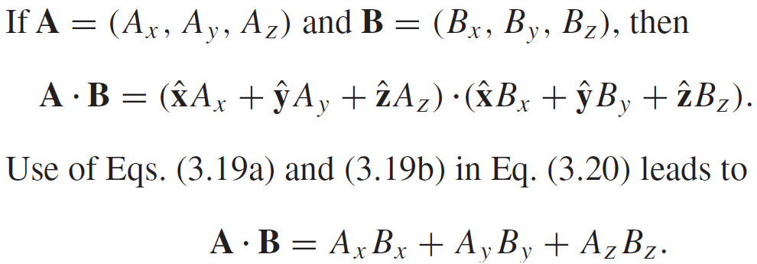
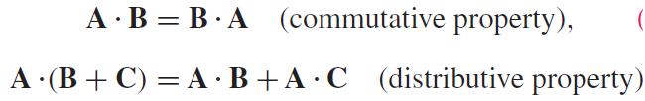
Vector Multiplication: Scalar Product or ”Dot Product”
Hence:

Slide 8
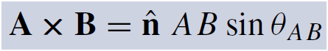
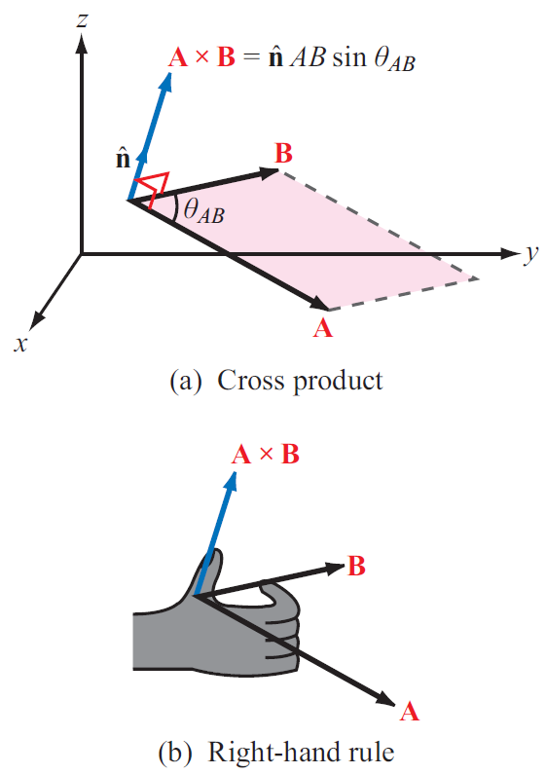
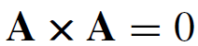
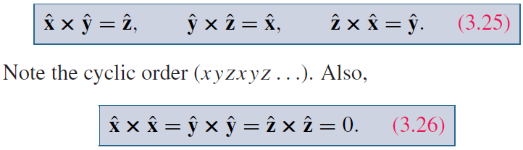
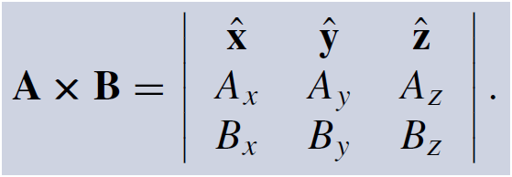
Vector Multiplication: Vector Product or ”Cross Product”

Slide 9
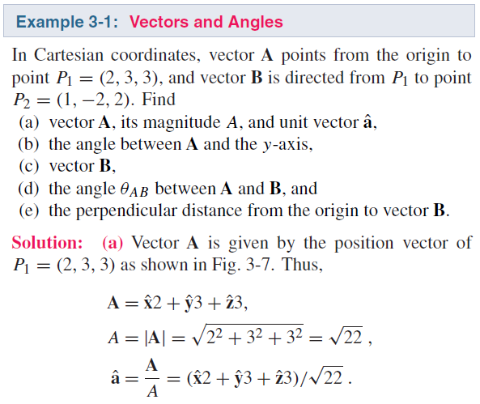
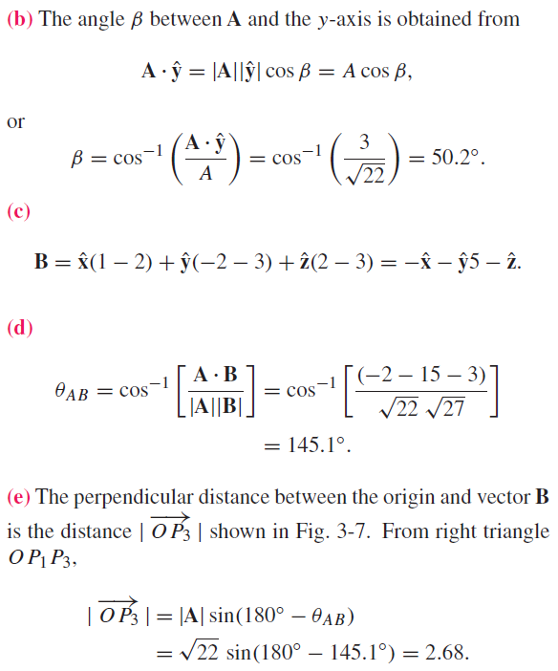
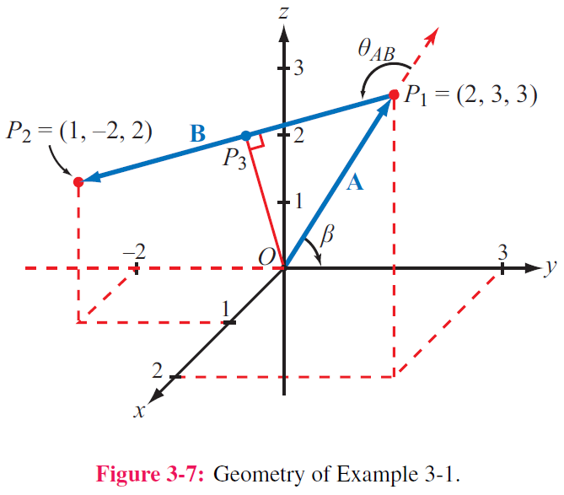

Slide 10
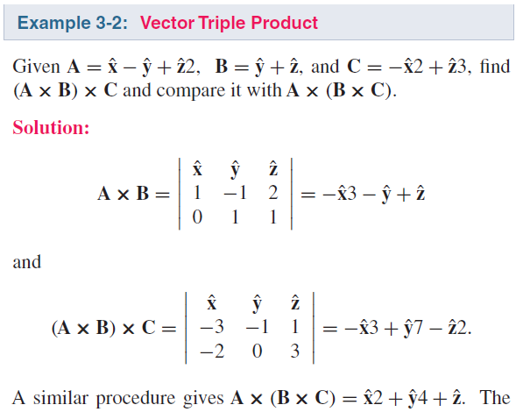
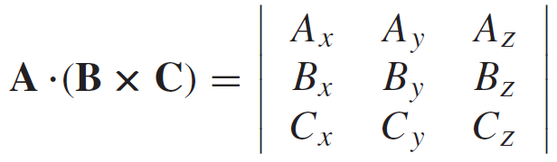
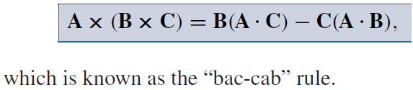
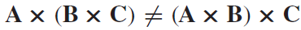
Triple Products
Scalar Triple Product
Vector Triple Product
Hence:

Slide 11
Orthogonal coordinate systems

Slide 12
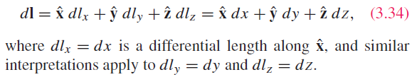
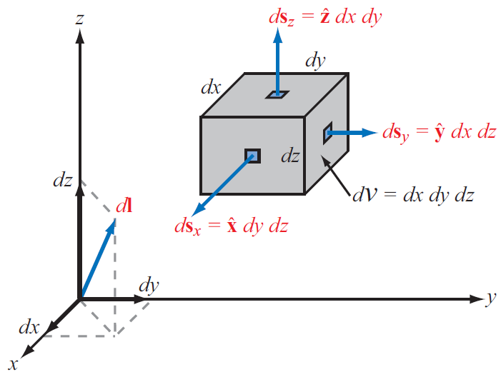
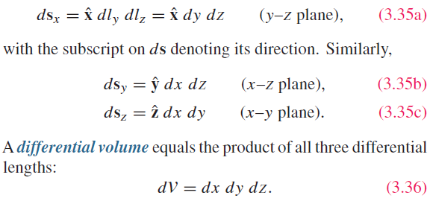
Cartesian Coordinate System
Differential length vector
Differential area vectors

Slide 13
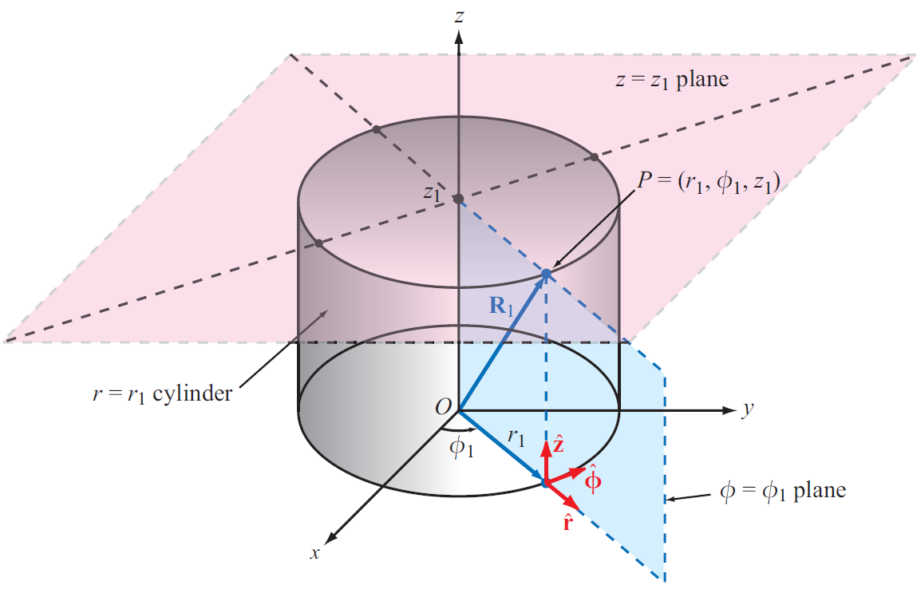
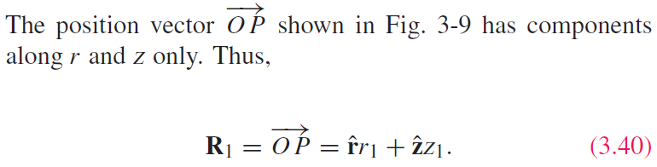
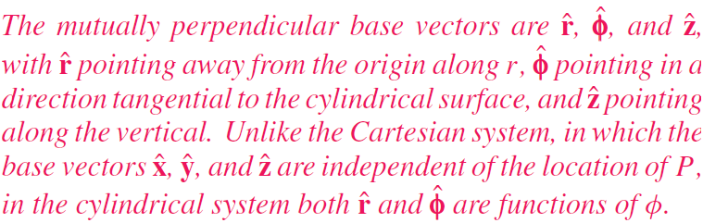
Cylindrical Coordinate System

Slide 14
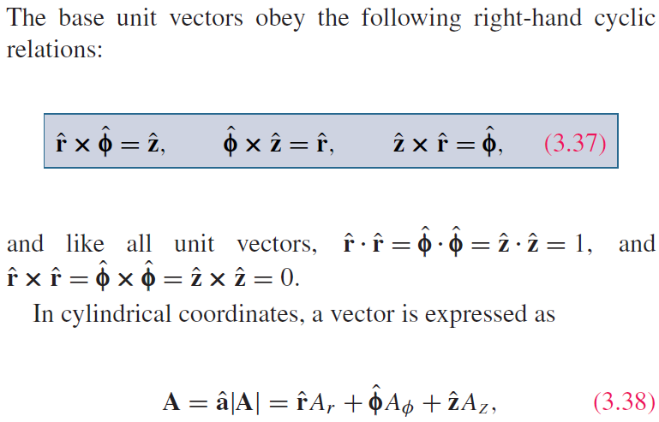
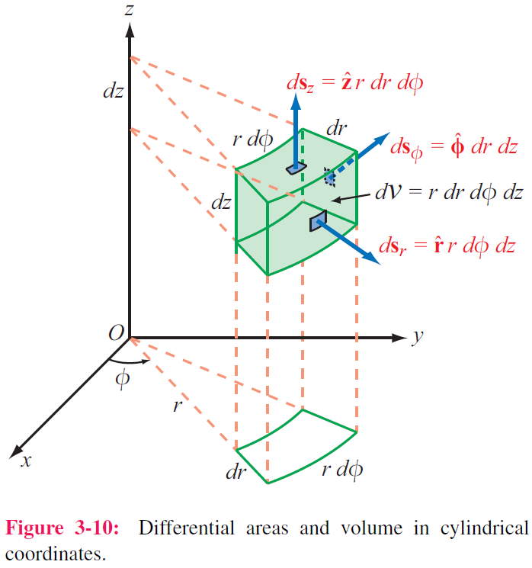
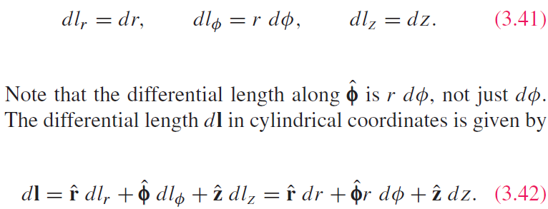
Cylindrical Coordinate System

Slide 15
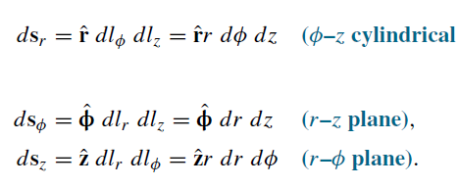
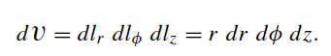
Cylindrical coordinate system
Differential area
Differential volume

Slide 16
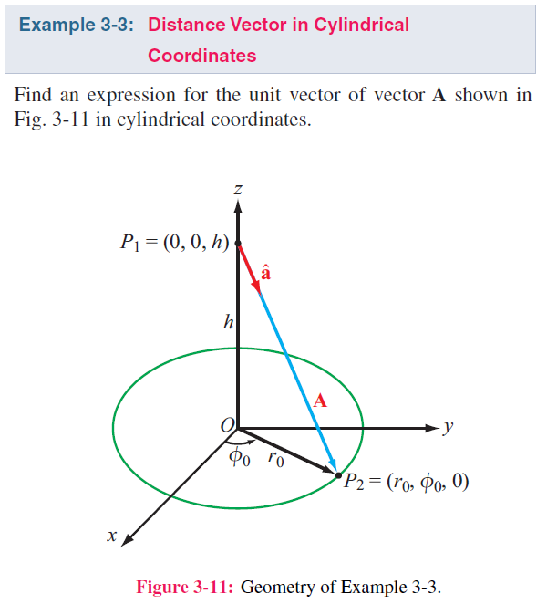
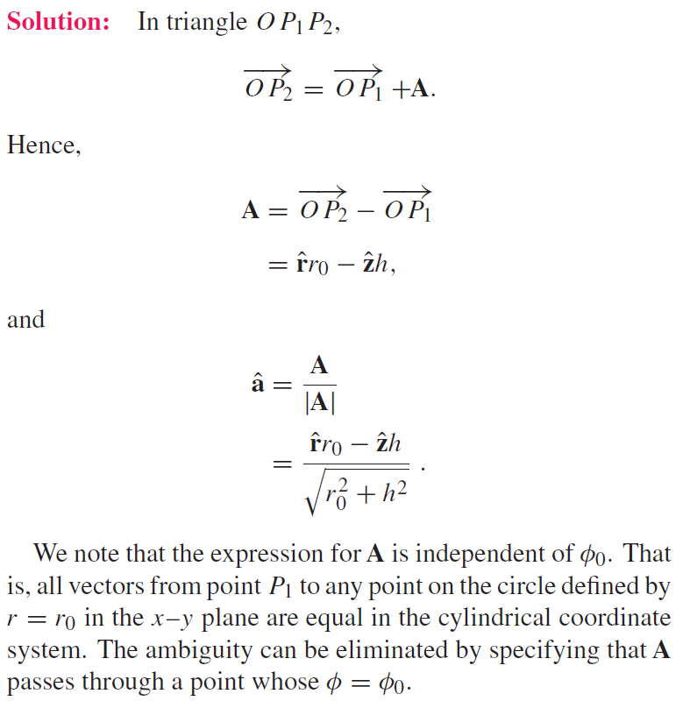

Slide 17
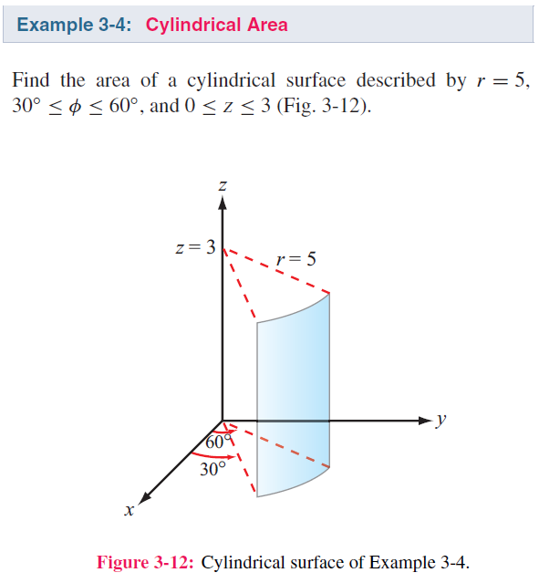
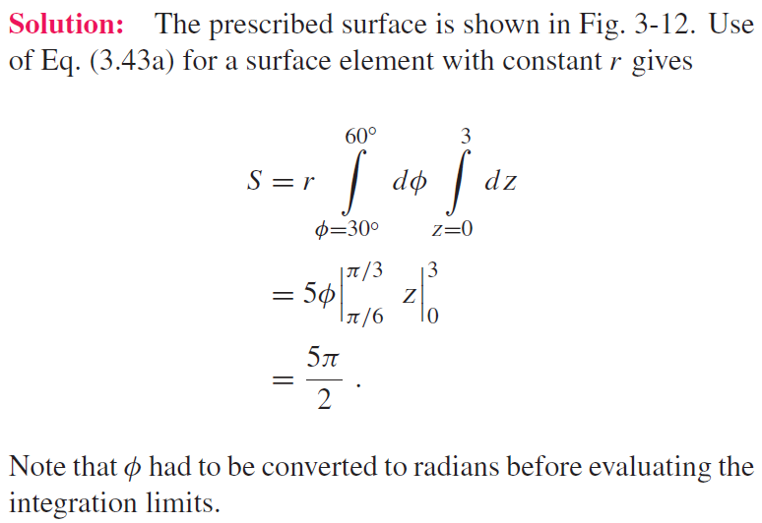

Slide 18
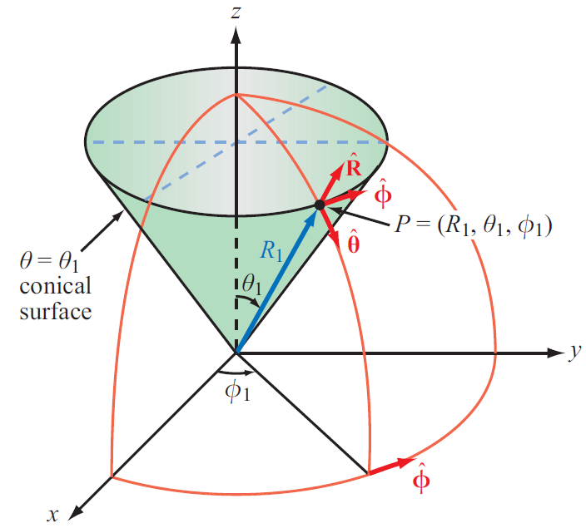
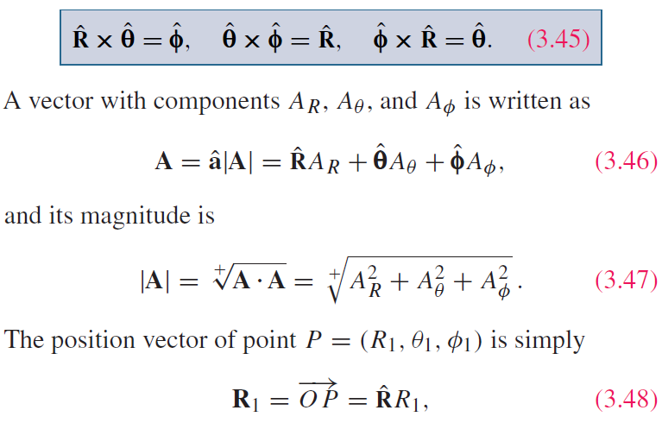
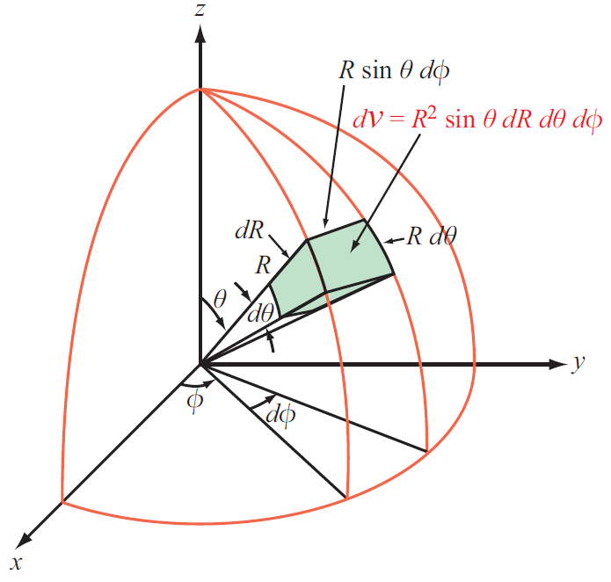
Spherical Coordinate System

Slide 19

Spherical coordinate system
Differential length, area and volume vectors

Slide 20




Slide 21


Slide 22

Technology Brief 5: GPS
How does a GPS receiver determine its location?

Slide 23
GPS: Three Segments
Space segment: 24 satellites (now 32) on six orbital planes at 20200 km altitude, circling Earth every 12 hours, transmitting continuous coded signals at 1.57542 and 1.22760 GHz
User segment: receivers, receiving and processing signals from multiple satellite signals, have many channels to monitor multiple satellites and distinguish them via special codes
Control segment: distributed around the world, monitoring the satellites and updating their precise orbital information

Slide 24



GPS: Minimum of 4 Satellites Needed
Unknown: location of receiver $(x_{0}, y_{0}, z_{0})$
Also unknown: time offset of receiver clock $t_{0}$
Quantities known with high precision: locations of satellites and their atomic clocks (satellites use expensive high precision clocks, whereas receivers do not)
Solving for 4 unknowns requires at least 4 equations (four satellites)

Slide 25


Coordinate Transformations: Coordinates
To solve a problem, we select the coordinate system that best fits its geometry
Sometimes we need to transform between coordinate systems

Slide 26





Coordinate Transformations: Unit Vectors
For Vectors
It is projection!

Slide 27



From Cartesian to Spherical
For coordinates

Slide 28




From Cartesian to Spherical
For unit vectors

Slide 29


Slide 30


Slide 31



Using the relations:
Leads to:

Slide 32



Distance Between 2 Points

Slide 33
Gradient, divergence, curl

Slide 34




Gradient of A Scalar Field
Define
$$T(x,y,z)$$

Slide 35





Gradient ( cont.)
$$\frac{dT}{dl}=∇T∙{\hat{a}}_{l}=\left|∇T\right|\cos{θ}$$
The directional derivative dT/dl is the projection of the gradient on ${\hat{a}}_{l}$. So the directional derivative gets its maximum value when the direction ${\hat{a}}_{l}$ is the same as the direction of the gradient. Put this in another way, the magnitude of the gradient is the maximum value of the directional derivative and the function varies fastest on its direction

Slide 36








Flux
Define flux for a vector field: the amount crossing outward of a surface
Total flux flowing through the surface S
Vector field
$$A$$
$$Φ=\int{A∙dS}$$
Open surface
$$S$$
Vector field
Closed surface

Slide 37

Divergence of a Vector Field
Flux on Face 1
（negative means inward）
Flux on Face 2

Slide 38



Derivation of Divergence
$$divE=∇∙E=\lim_{∆V→0}{\frac{∯{E∙dS}}{∆V}}$$
$$S$$

Slide 39





Physical Meaning of Divergence
$$∇∙A\left(x_{0},y_{0},z_{0}\right)>0$$
$$∇∙A\left(x_{0},y_{0},z_{0}\right)<0$$
$$\left(x_{0},y_{0},z_{0}\right)$$
$$\left(x_{0},y_{0},z_{0}\right)$$

Slide 40

Divergence Theorem
The volume integral of divergence equals to the flux through the closed surface that bounds the volume
Useful tool for converting integration over a volume to one over the surface enclosing that volume, and vice versa

Slide 41



Slide 42



An Example
In case the position under study is away from the charge, L$≠0$
+q
$$∇∙E=\frac{q}{4πε}\frac{1}{R^{2}}\frac{∂}{∂R}\left(R^{2}\frac{1}{R^{2}}\right)=0$$

Slide 43




An Example
In case the position under study is at the charge, L$=0$
$$\left(∇∙E\right)V=\left|E\right|4πR^{2}=\frac{q}{ε}$$
$$∇∙E=\frac{q}{εV}=\frac{ρ_{v}}{ε}$$

Slide 44

Another Example
From the last example, one may consider that a vector field with only R component and only varying with R purely has nonzero divergence at R = 0. Is this true?

Slide 45




Curl of a Vector Field
Right-hand rule

Slide 46

Physical Meaning of Curl
$$∇×A\left(x_{0},y_{0},z_{0}\right)≠0$$
If curl of a vector field A at a point is not zero, this means the field A has an overall rotational feature at this point. The direction of the curl is defined by the rotation direction
(x₀, y₀, z₀)
(x₀, y₀, z₀)

Slide 47




An Example

Slide 48

Another Example
From the last example, one may consider that the location where a magnetic field can get nonzero curl is at the place with a current source. And if no source at a location, then the curl here must be 0. Is this true?

Slide 49


Stokes’s Theorem
Obtained from the definition of curl

Slide 50



Laplacian Operator
Laplacian of a Scalar Field
Laplacian of a Vector Field
Useful Relation

Slide 51




Units
How does the unit change after performing the operation of gradient, divergence and curl?
Faraday’s Law
$$\frac{V}{m}\frac{1}{m}=\frac{H}{m}\frac{A}{m}\frac{1}{s}$$
$$V=\frac{HA}{s}$$
$$Ω=\frac{H}{s}$$

Slide 52

Homework due xxx

